Slide 1
DFO Shellfish Aquaculture Research Update
Chris Pearce
Fisheries and Oceans Canada
(and a cast of thousands, well dozens maybe)

Slide 2
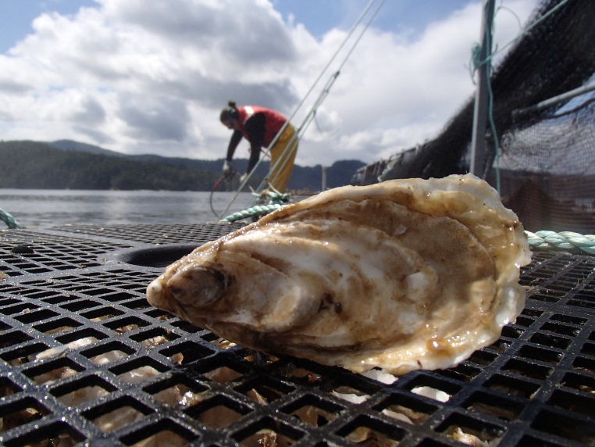
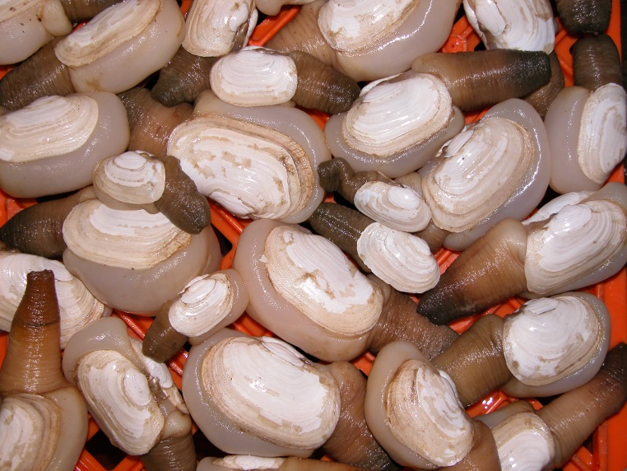
Talk Overview
(1) Shellfish aquaculture and microplastics
(2) Sea urchin aquaculture
(3) Sea cucumber aquaculture
(4) Geoduck aquaculture
(5) Oyster aquaculture and aquatic invasive species removal

Slide 3
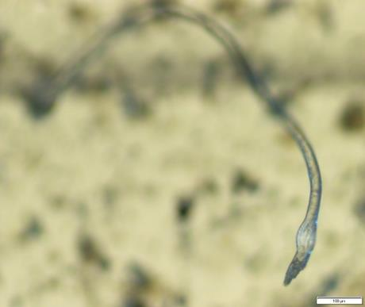
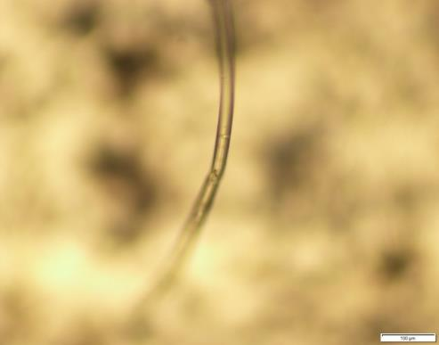
Microplastics
Polyester fibre
Nylon fibre
HQP: Garth Covernton (MSc/PhD, UVic), Monique Raap (MSc, UVic), Matt Miller (Undergrad, VIU), Maggie Dietterle (Undergrad, VIU)
Collaborators: Dr. Sarah Dudas (VIU/DFO), Dr. Helen Gurney-Smith (VIU/DFO), Dr. John Dower (UVic), Dr. Peter Ross (Ocean Wise), BCSGA (and various growers)
Funding: ACRDP, BCSGA

Slide 4
Microplastics (Sampling Points)
Out-plant: May/Jun
Collection: Aug/Sep
5 quadrats per site
12 clams/10 oysters per quadrat

Slide 5
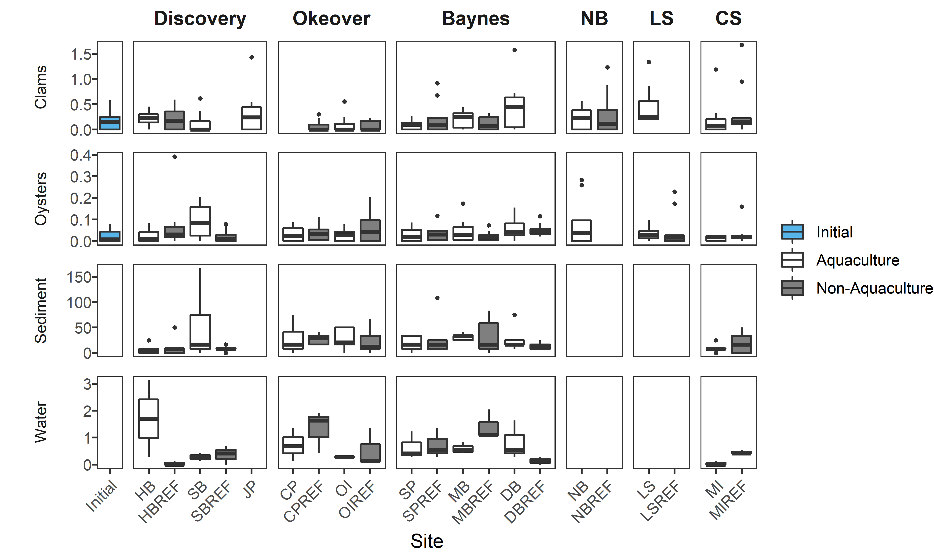
Microplastics (Concentrations)

Slide 6
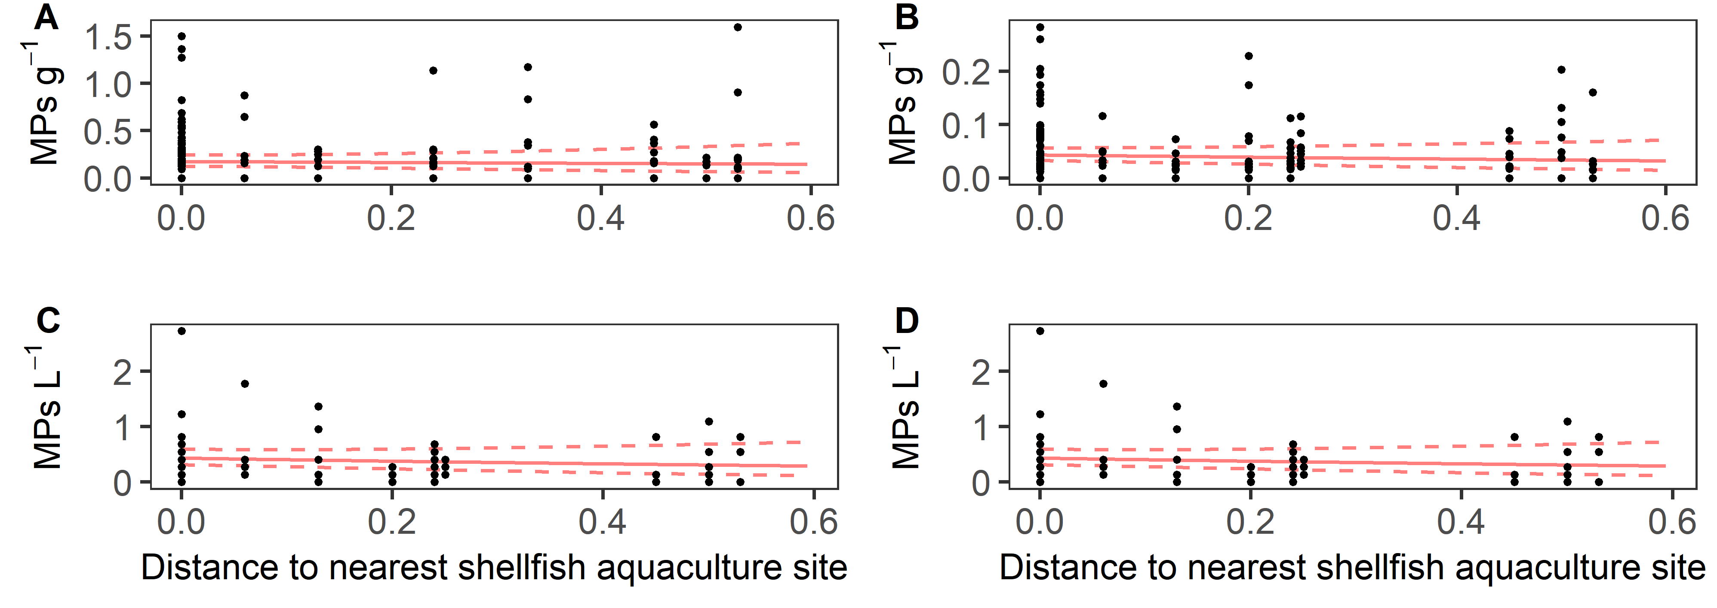
Microplastics (Concentrations)
Clams
Oysters
Water
Sediment

Slide 7
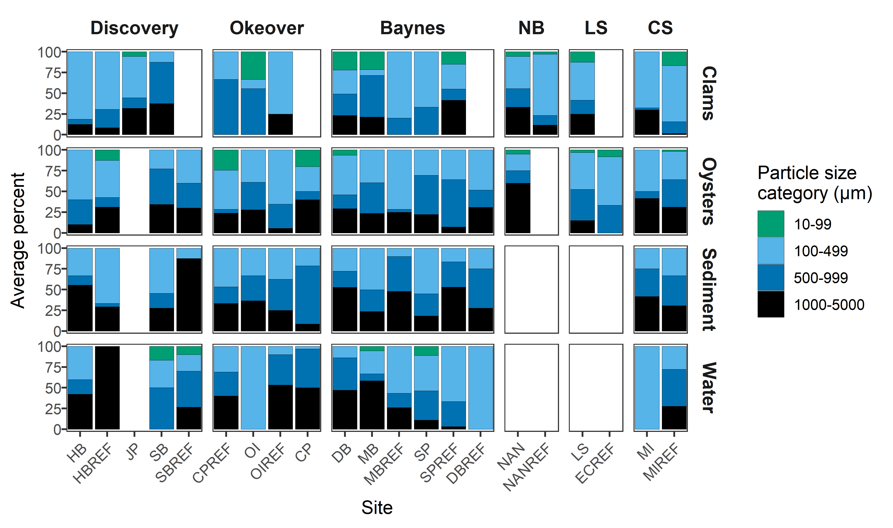
Microplastics (Sizes)

Slide 8
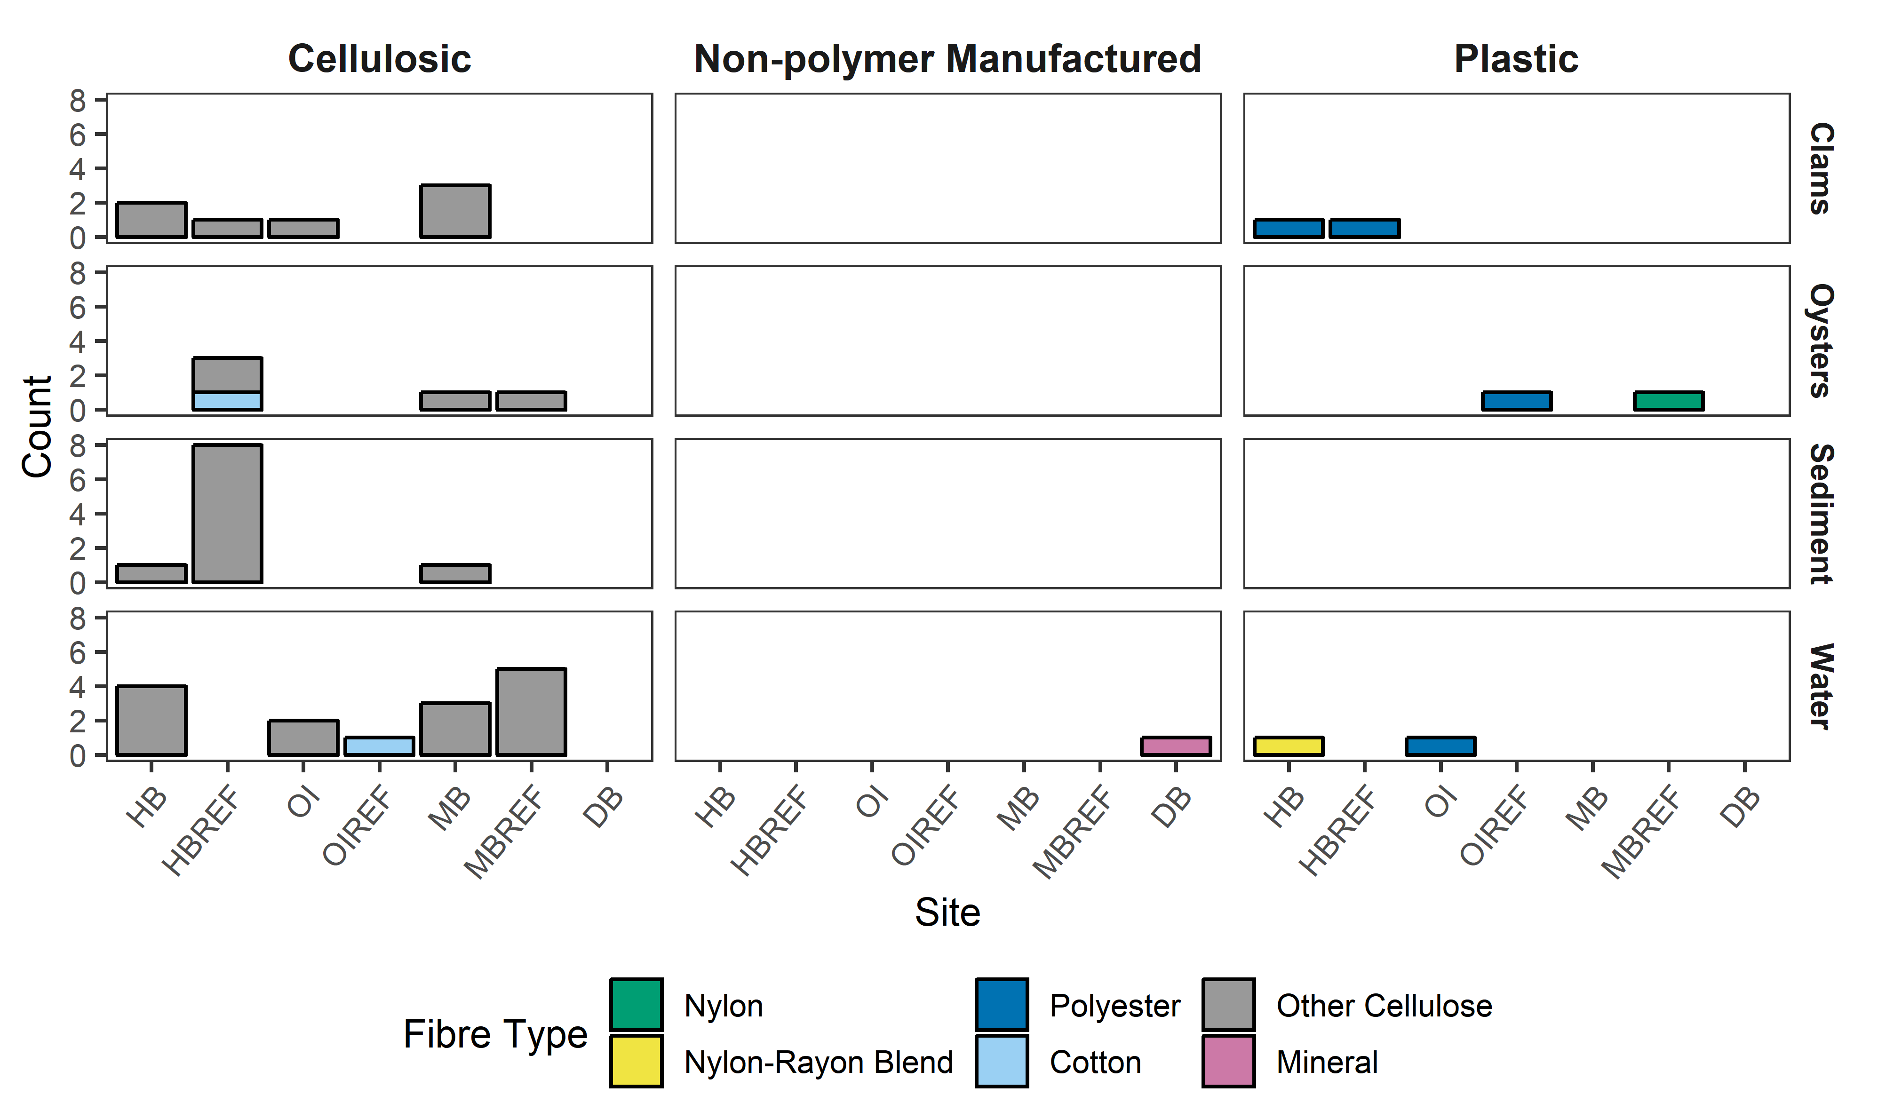
Microplastics (Particle Composition)
44 particles under FTIR:
~73% error rate for shellfish
~83% error rate for water

Slide 9
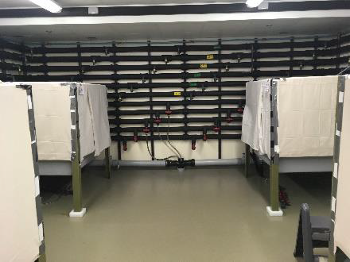
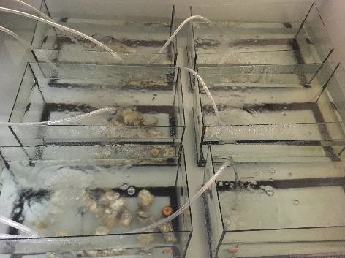
Microplastics (Depuration)
Cultured oysters kept in the laboratory under “non-plastic” conditions
Putative microplastic concentrations examined at 0, 1, 3, 5, and 10 d

Slide 10
Microplastics (Depuration)

Slide 11
Microplastics (Growth and Genomics)
Shellfish fed microplastic particles in the laboratory at natural concentrations (~5 microplastic particles per liter) versus control animals without microplastic particles
Genomic response examined at 3 hours and 14 days

Slide 12
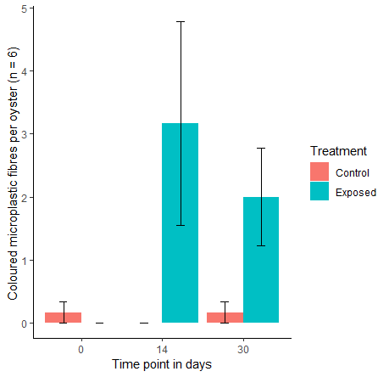
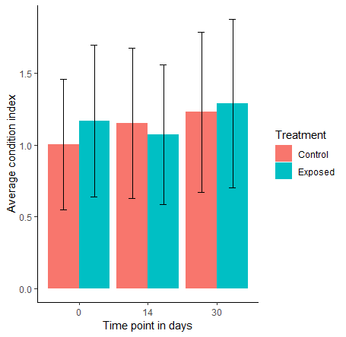
Microplastics (Growth)
Presence of microplastics did not significantly alter body condition index compared to control oysters without microplastics

Slide 13
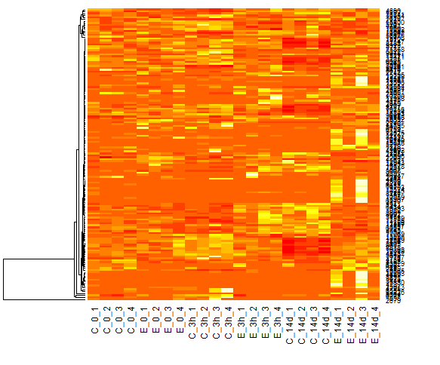
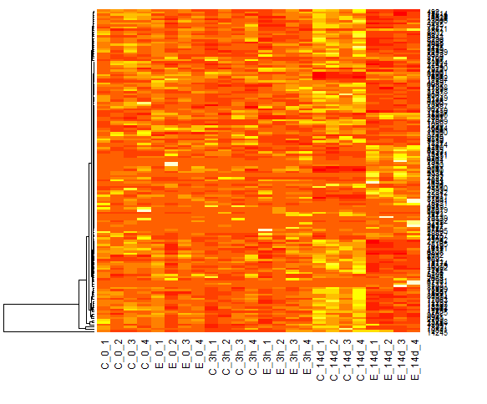
Microplastics (Genomics)
Heatmap of top 150 differentially-expressed genes between control (C) and exposed (E) Pacific oyster digestive gland tissues at time points 0 hours, 3 hours, and 14 days (14d). Yellow/white bands are upregulated genes and orange/red bands are downregulated genes.

Slide 14
Microplastics (Genomics)
Genes involved in immunity, defense, degradation, stress, signaling, wound repair, structural constituents, oxidizing, and cell adhesion had significantly (p ≤ 0.015) increased levels of gene expression in animals exposed to microplastics compared to those without microplastic exposure.

Slide 15
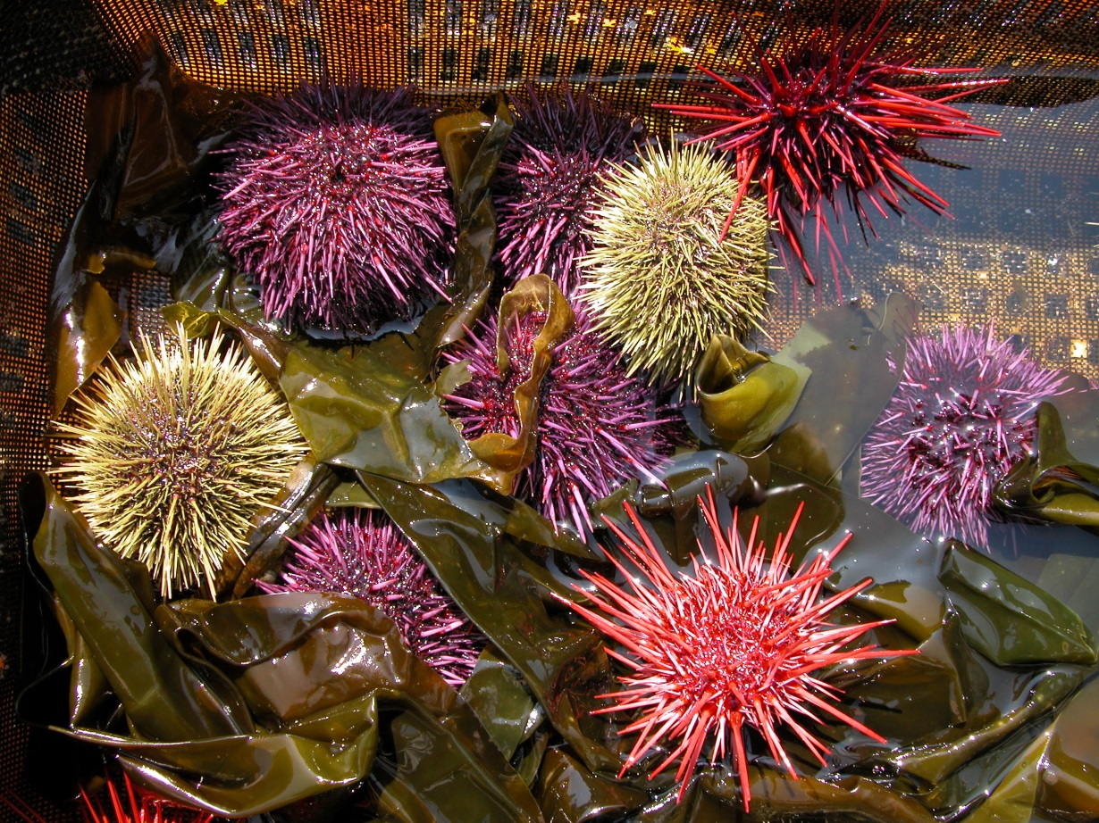
Sea Urchins
HQP: Emily Warren (MSc, UVic), Julia Savery (Undergrad, VIU)
Collaborators: Dr. Stephen Cross (UVic), Dr. Stefanie Duff (VIU), Lyanne Curtis (DFO), Urchinomics, Nova Harvest Ltd.
Funding: DFO, Urchinomics

Slide 16
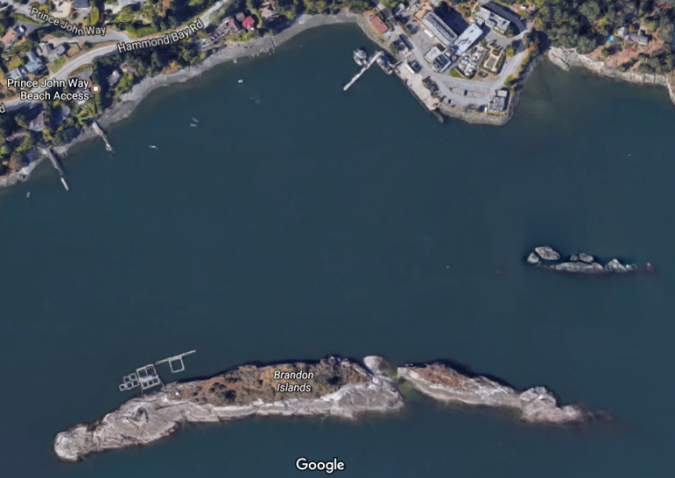
Sea Urchins
Pacific Biological Station
PBS Farm Site

Slide 17
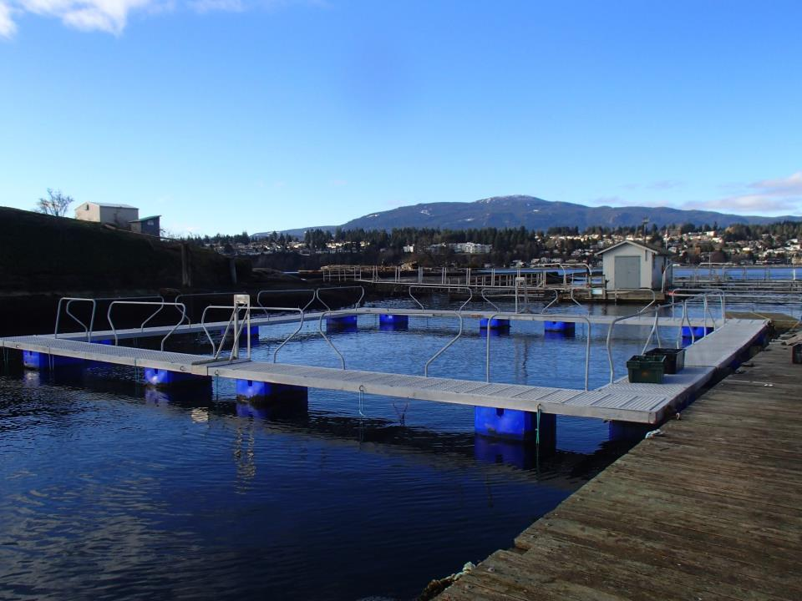
Sea Urchins
Pacific Biological Station
PBS Farm Site

Slide 18
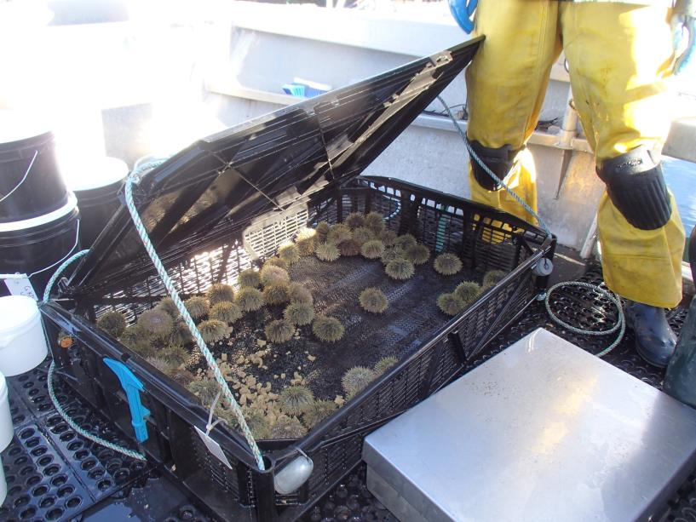
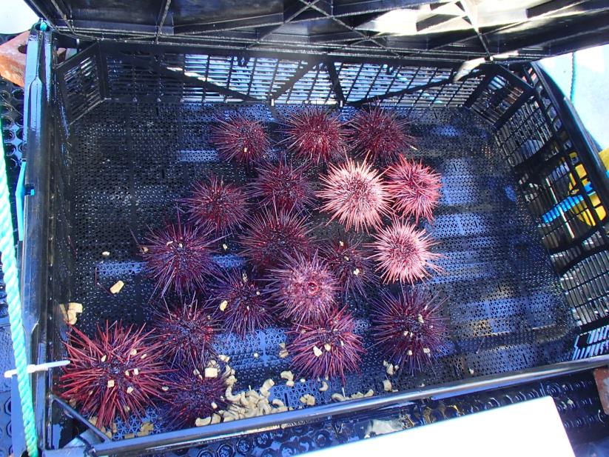
Sea Urchins
Pacific Biological Station
PBS Farm Site

Slide 19
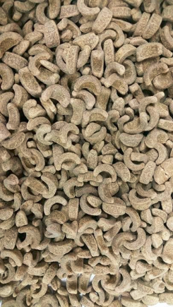
Sea Urchins
Pacific Biological Station

Slide 20
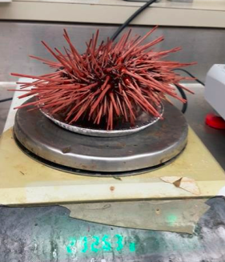
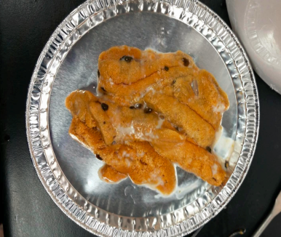
Sea Urchins
Pacific Biological Station
PBS Farm Site
  Test diameter, test height, spine width, urchin wet weight, roe yield, and roe quality were measured (CIE scale and “1-4” scale) at weeks 0, 3, 6, 9, and 12.

Slide 21
Sea Urchins
Pacific Biological Station
PBS Farm Site

Slide 22
Sea Urchins
Pacific Biological Station
PBS Farm Site

Slide 23
Sea Urchins
Pacific Biological Station
PBS Farm Site

Slide 24
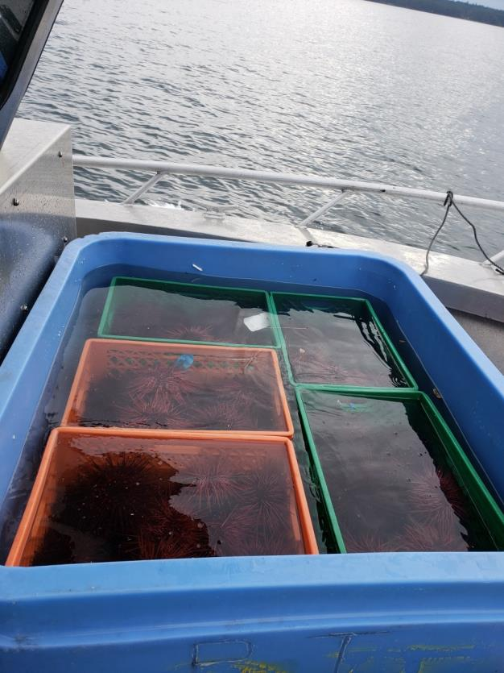
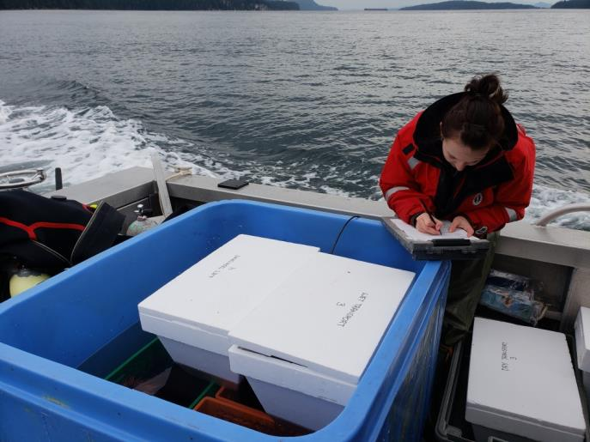
Sea Urchins (Transportation)
Pacific Biological Station
PBS Farm Site
3 replicates, 4 urchins per replicate
Dry transport: 5 dead
Wet transport (Styrofoam boxes): 0 dead
Wet transport (cages): 0 dead

Slide 25
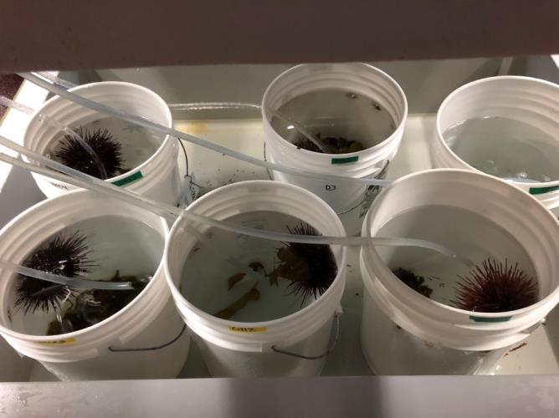
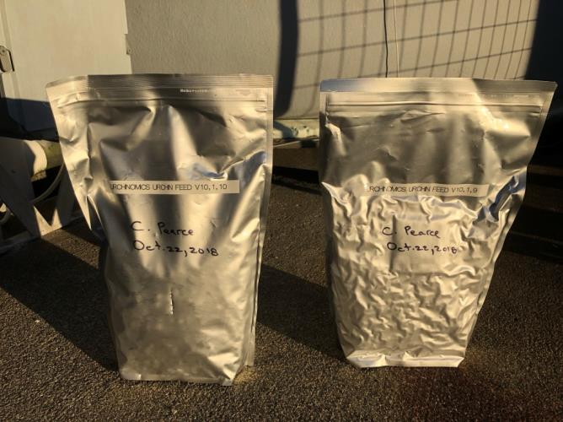
Sea Urchins (Future Work)
Pacific Biological Station
PBS Farm Site
New feeds and kelp
  New high-kombu feeds produced by Mitsubishi
Gonad enhancement: colour, flavour
DEPOMOD: to assess benthic impacts

Slide 26
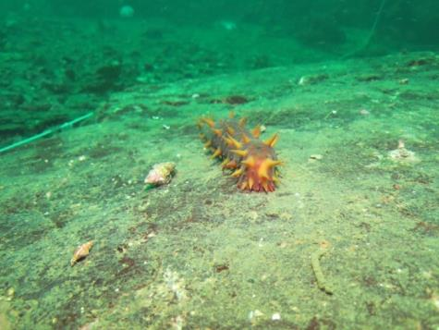
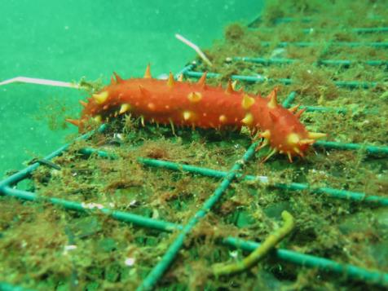
Sea Cucumbers
Pacific Biological Station
Photo Credit: Dan Curtis
Photo Credit: Dominique Bureau
HQP: Dr. Dan Curtis (Post-doc, DFO), Dr. Lucie Hannah (Post-doc, DFO), Paul van Dam-Bates, (MSc, UVic), Lindsay Orr (MSc, UVic), Debbie Paltzat (MSc, UBC)
Collaborators: Dr. Stephen Cross (UVic), Dr. Laura Cowen (UVic), Dr. Helen Gurney-Smith (VIU/DFO), Dr. Scott McKinley (UBC), Dr. Penny Barnes (VIU), Klahoose FN, Viking Bay Ventures, Kyuquot SEAfoods Ltd., Fan Seafoods Ltd.
Funding: ACRDP, NSERC, Klahoose FN, Viking Bay Ventures, Kyuquot SEAfoods Ltd., Fan Seafoods Ltd.
PBS Farm Site

Slide 27
Ingest/Digest Farm Waste?
*
*
Lab-based trials (24 h) with natural sediment (~2% TOM) and sablefish waste (~86% TOM)
Sea cucumbers actively consume and digest sablefish waste

Slide 28
Impact Organic Accumulation?
 |  | % TOC |  |  | % TN
 |  | Mean | SE |  | Mean | SE
Sablefish feed |  | 23.49 | - |  | 2.29 | -
Sablefish faeces & uneaten feed mix |  | 47.37 | 0.206 |  | 6.36 | 0.042
Sea cucumber faeces
Experimental
 | Small | 18.79 | 5.178 |  | 2.40 | 0.719
 | Large | 18.68 | 5.199 |  | 2.27 | 0.214
Sea-based trials in suspended cages under sablefish pens
Sea cucumbers reduce %TOC and %TN by ~ 60%

Slide 29
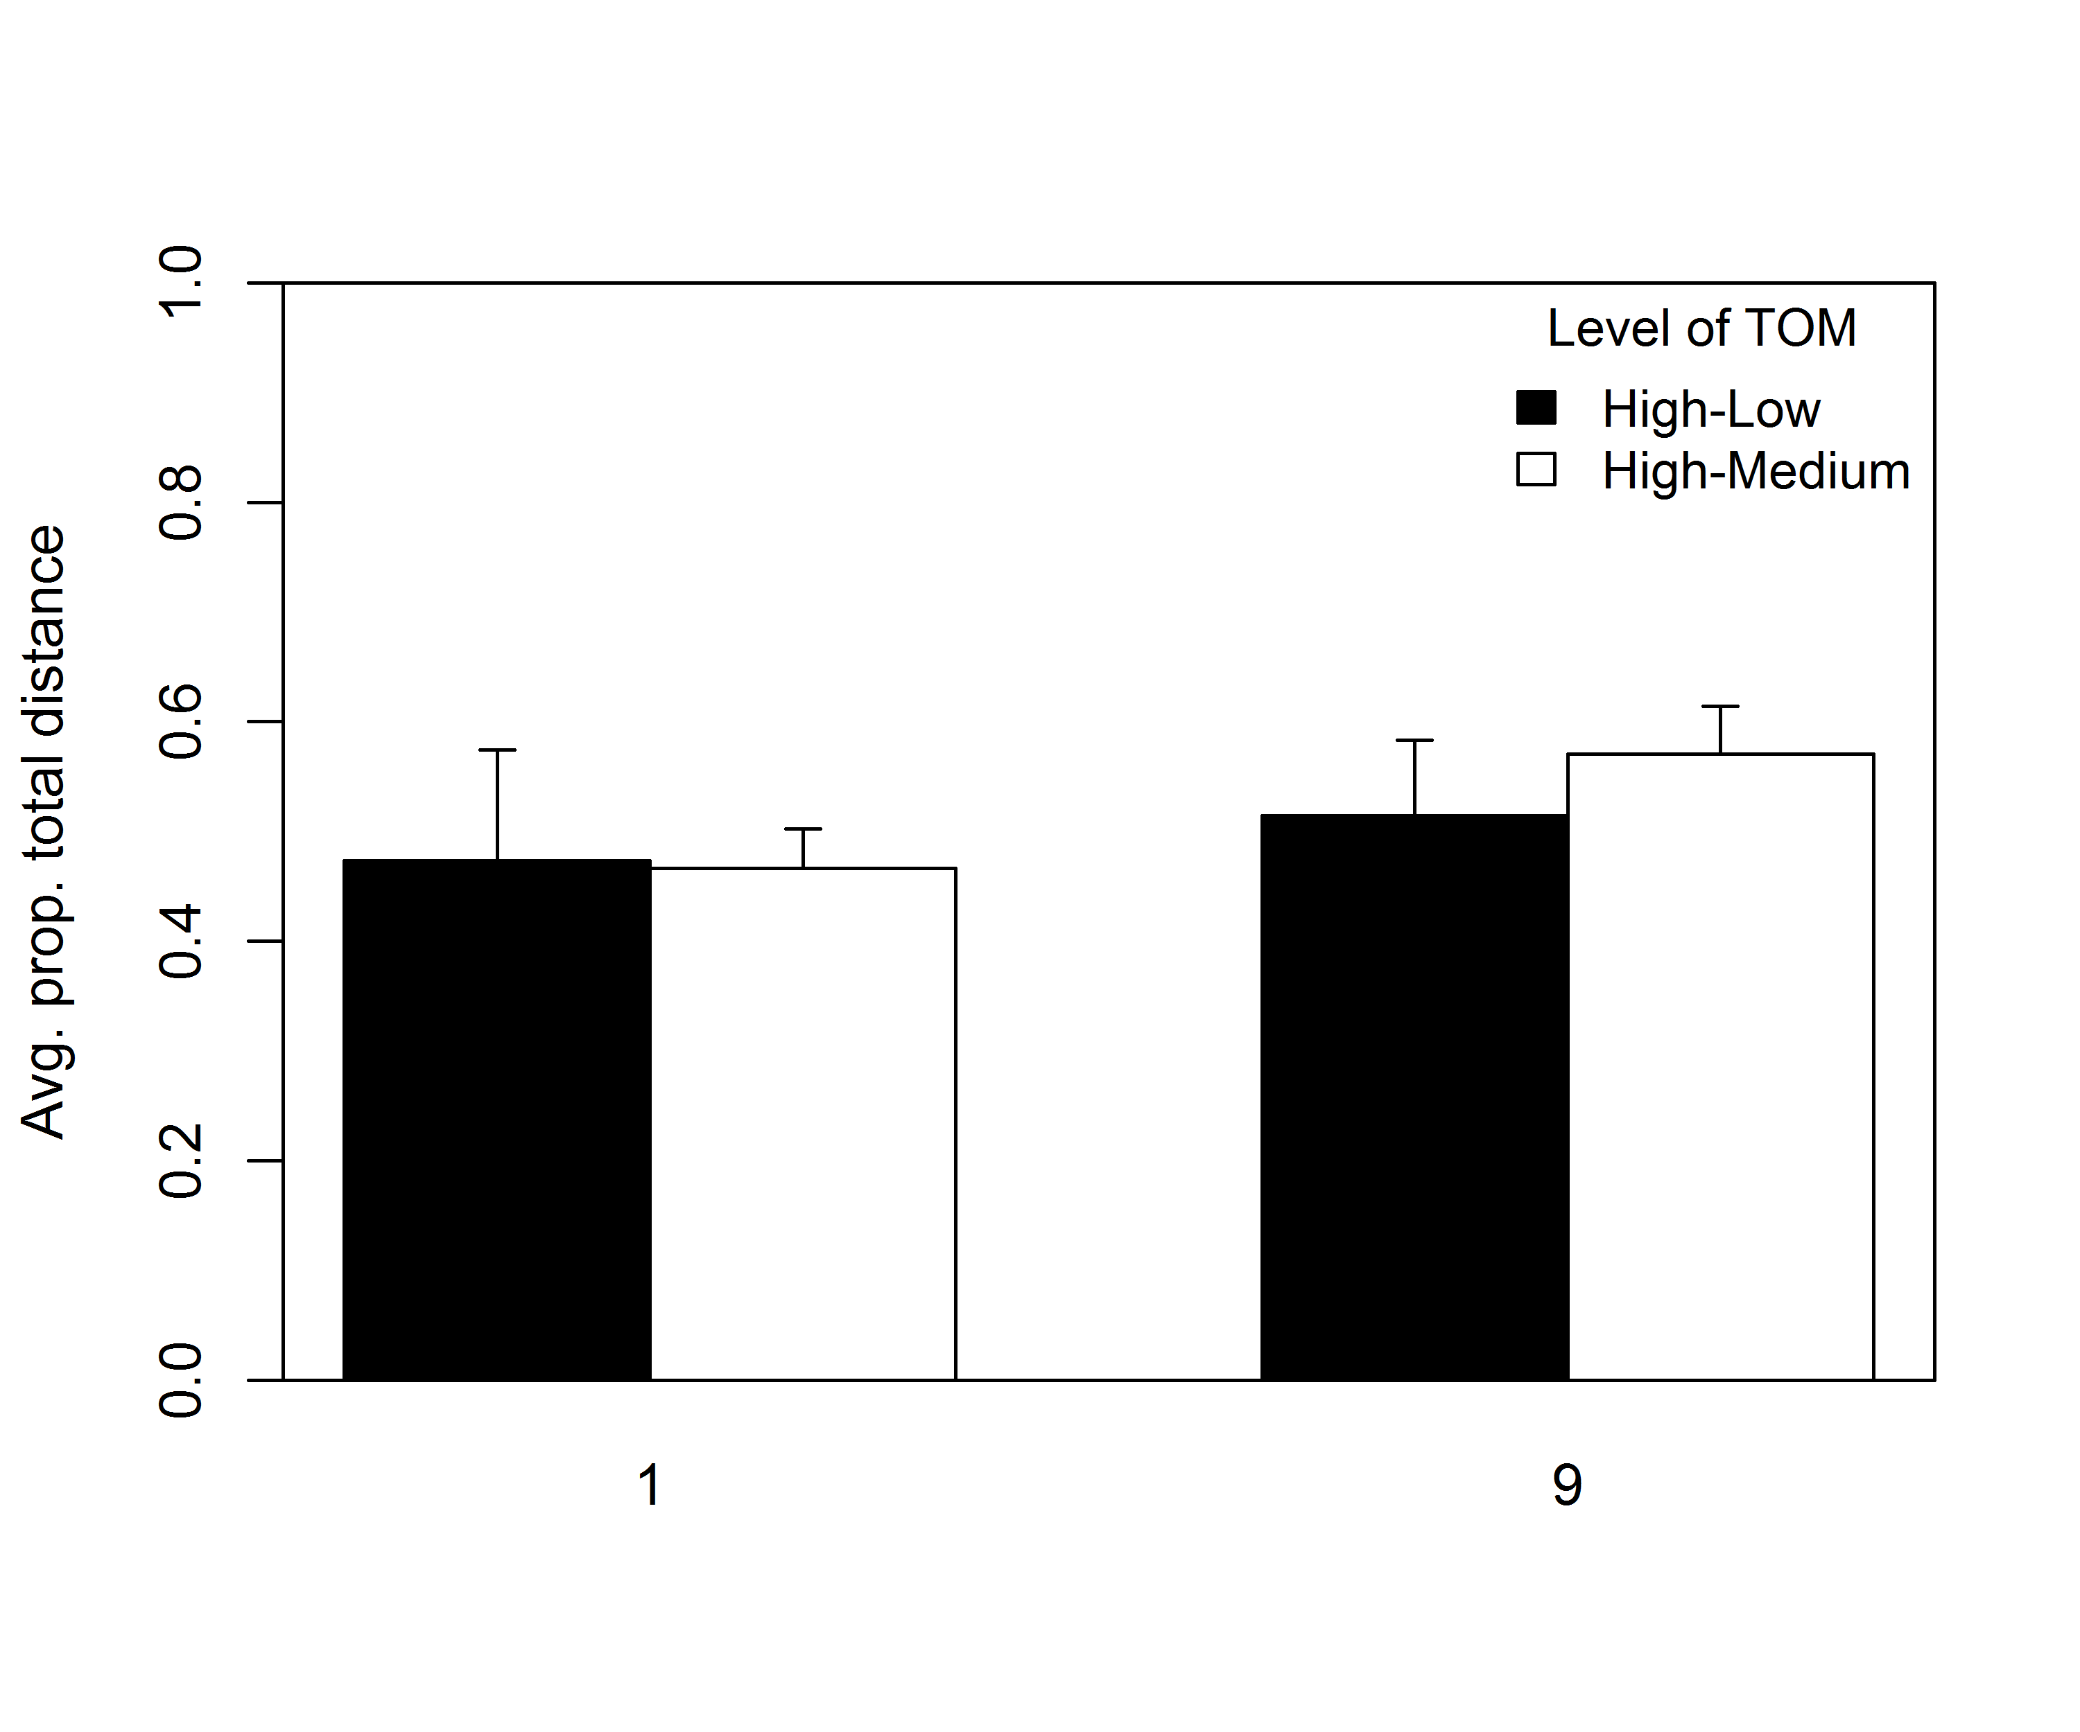
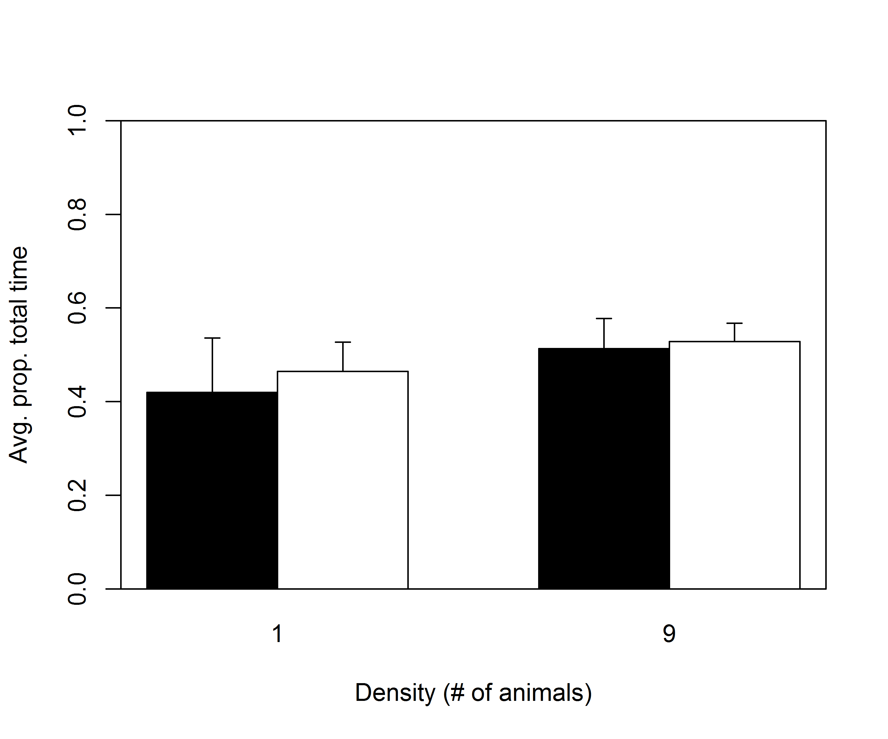
Seek Out Areas of High Organics?
Lab-based trials (24 h) in 3-m diameter tanks
Sea cucumbers do not actively choose high (8.8% TOM) over medium (4.4% TOM) or low (1.4% TOM) organic content

Slide 30
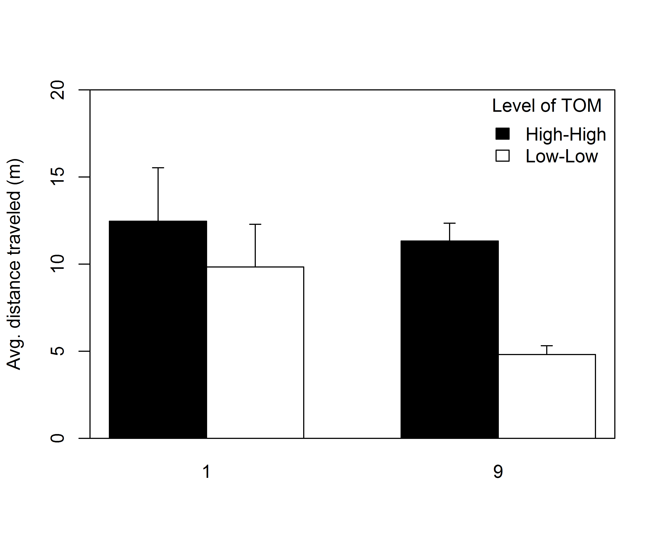
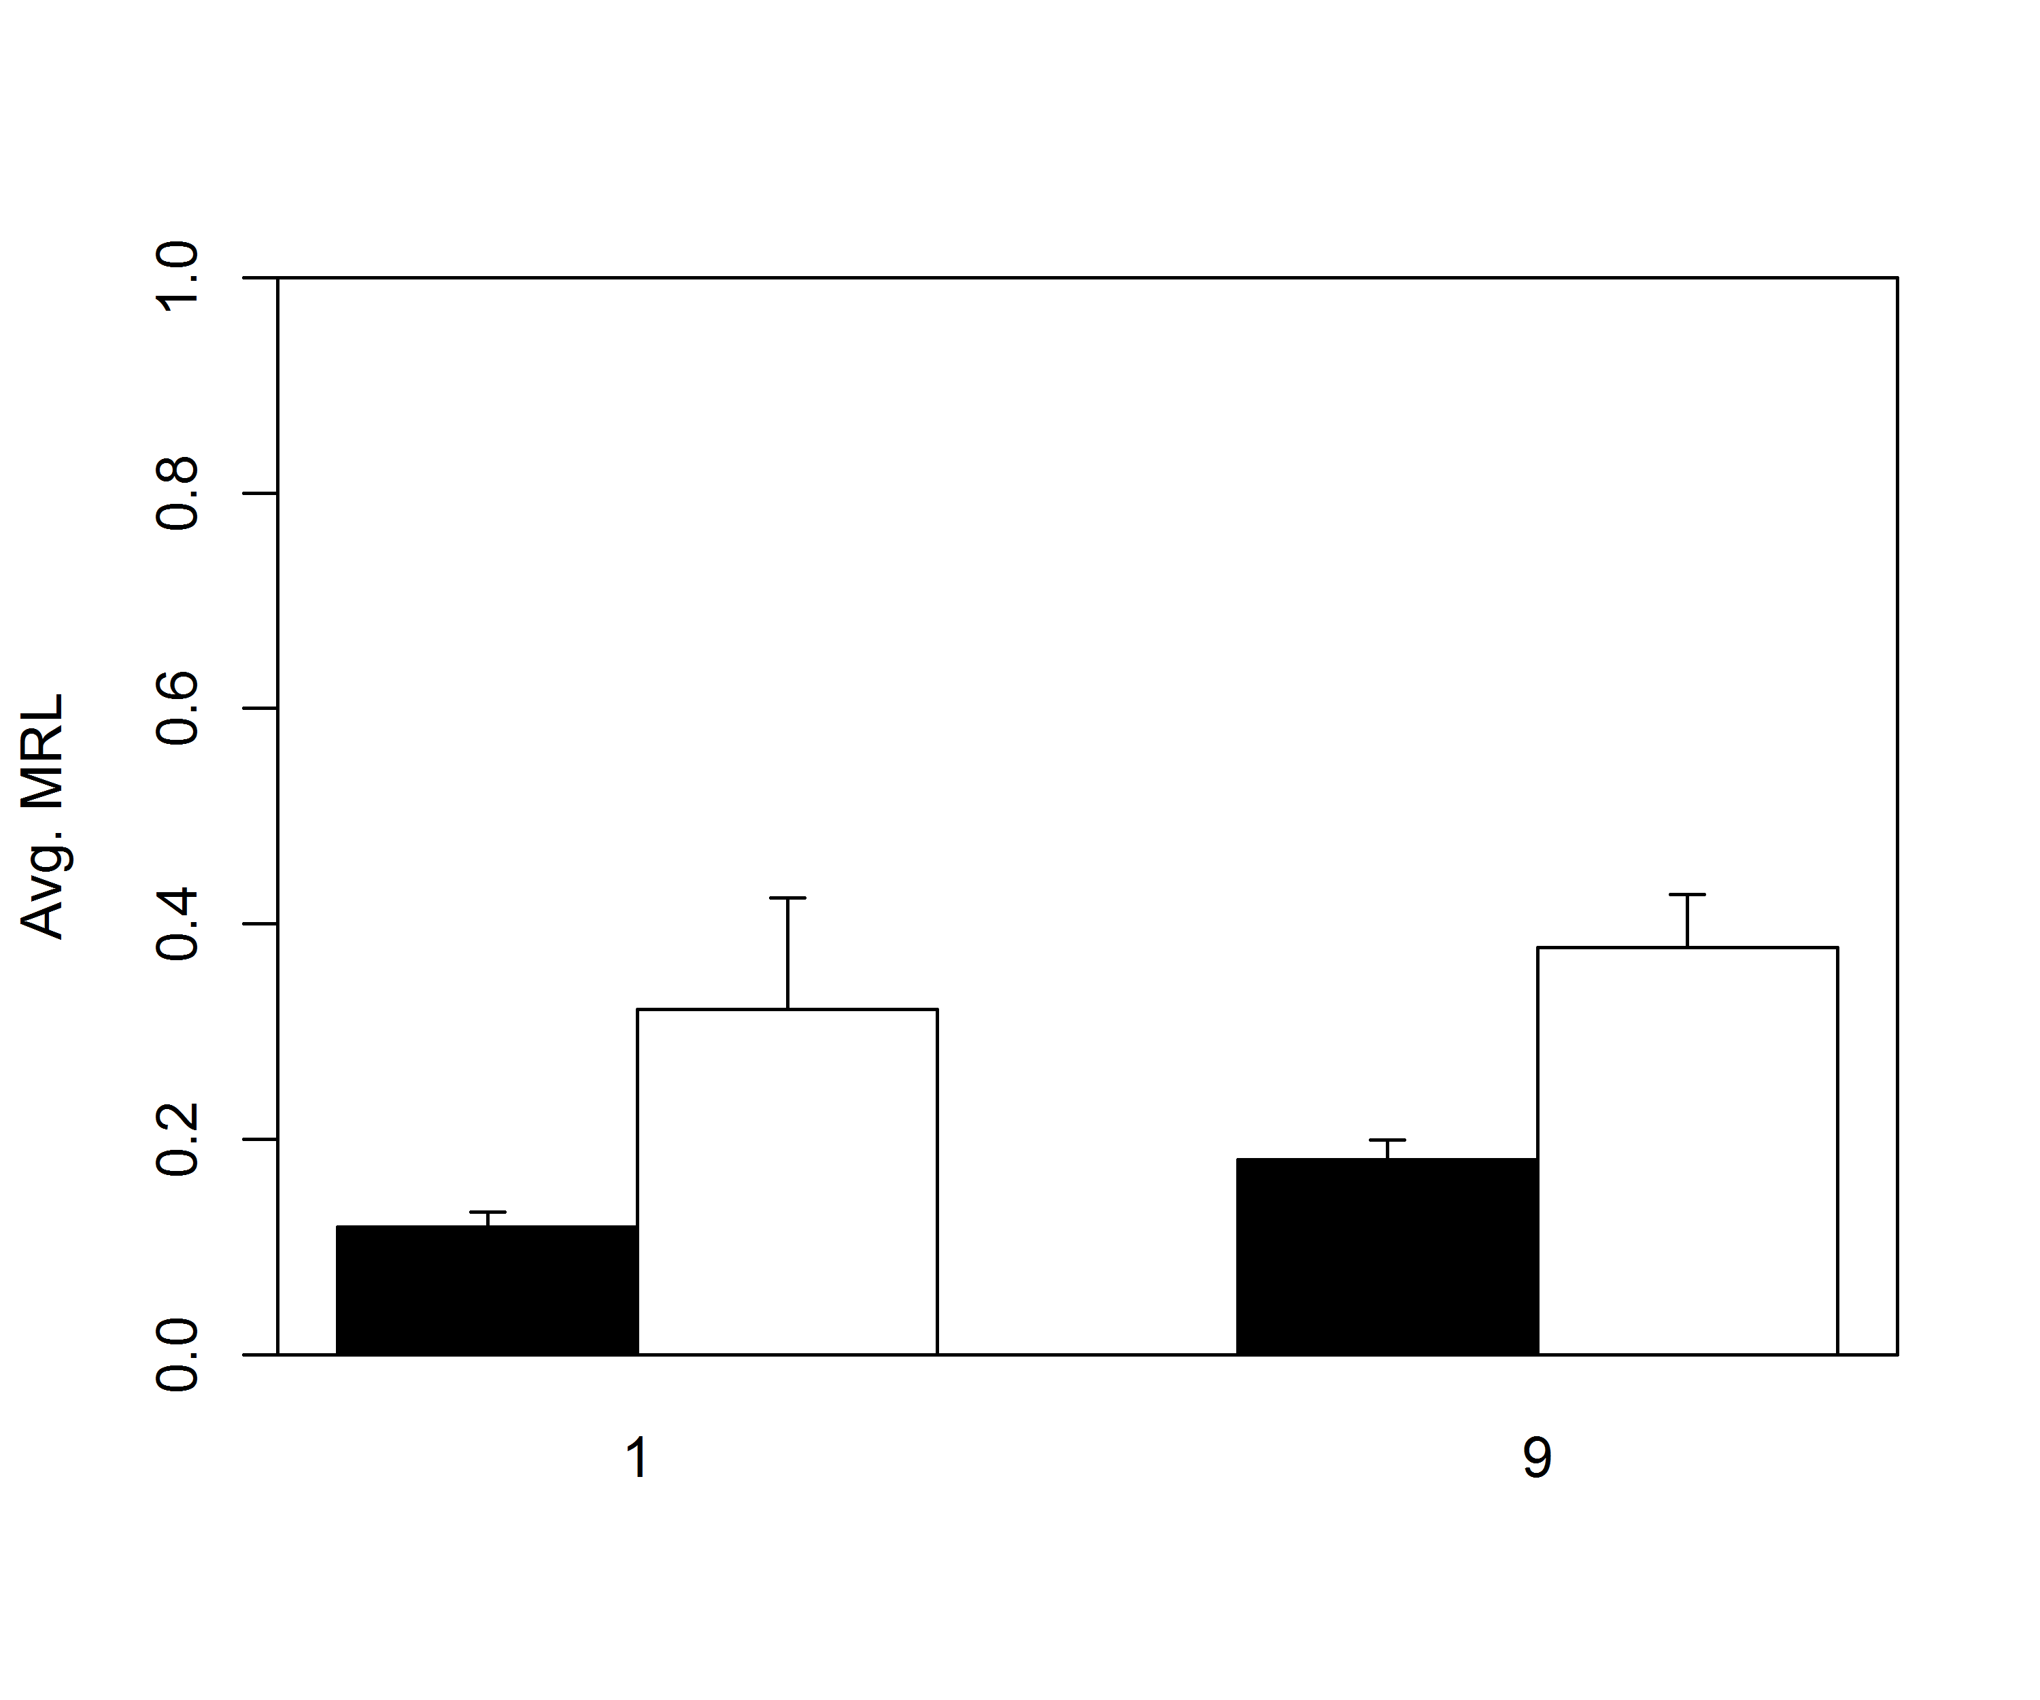
Seek Out Areas of High Organics?
High TOM > Low TOM
High TOM < Low TOM
MRL = mean resultant length
Lab-based trials (24 h) in 3-m diameter tanks
Sea cucumbers travel farther and show more random movement in high TOM versus Low TOM

Slide 31
Seek Out Areas of High Organics?
 | % Organic content |  |  | % Assimilation efficiency (mean ± SE)
Site | Tray sediment (mean ± SE) | Foregut (mean ± SE) | Hindgut (mean ± SE)
VB | 5.93 ± 0.53 | 25.57 ± 2.55 | 14.69 ± 0.56 | 39.10 ± 12.91
GH | 5.92 ± 0.57 | 23.76 ± 3.48 | 14.21 ± 1.71 | 41.70 ± 8.57
Sea-based trials in suspended trays under oyster rafts
Sea cucumbers selectively choose organic matter when feeding

Slide 32
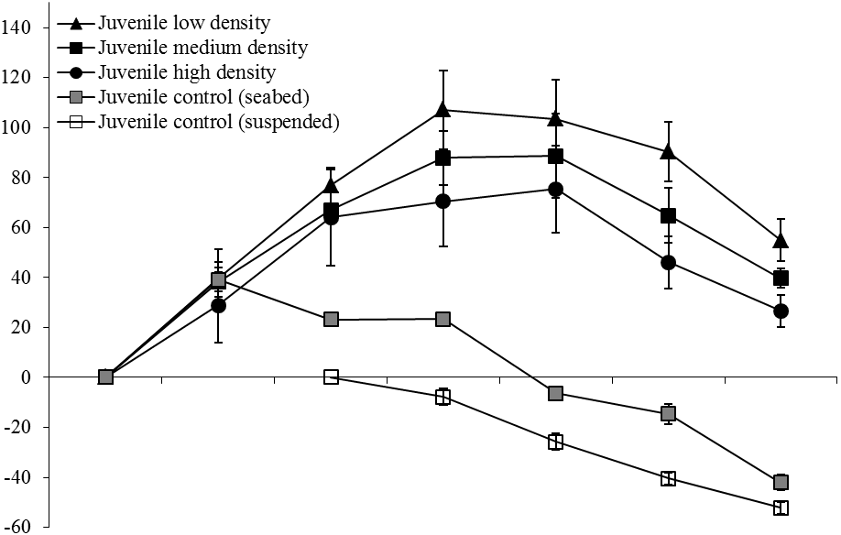
Grown in Suspended Cages?
Small Sea Cucumbers
Experimental low density
Experimental medium density
Experimental high density
Seabed control medium density
Suspended control medium density
A
A
B
C
Change in whole wet weight (%)
Sampling date
Nov-08
Jan-09
Mar-09
May-09
Jul-09
Sep-09
Dec-09
C
B
A
A
A
A
B
Sea-based trials in suspended trays under sablefish pens and controls
Seasonal growth of sea cucumbers (>95% survival for experimental trays)
Effect of density (12, 17, and 21 ind m⁻²)

Slide 33
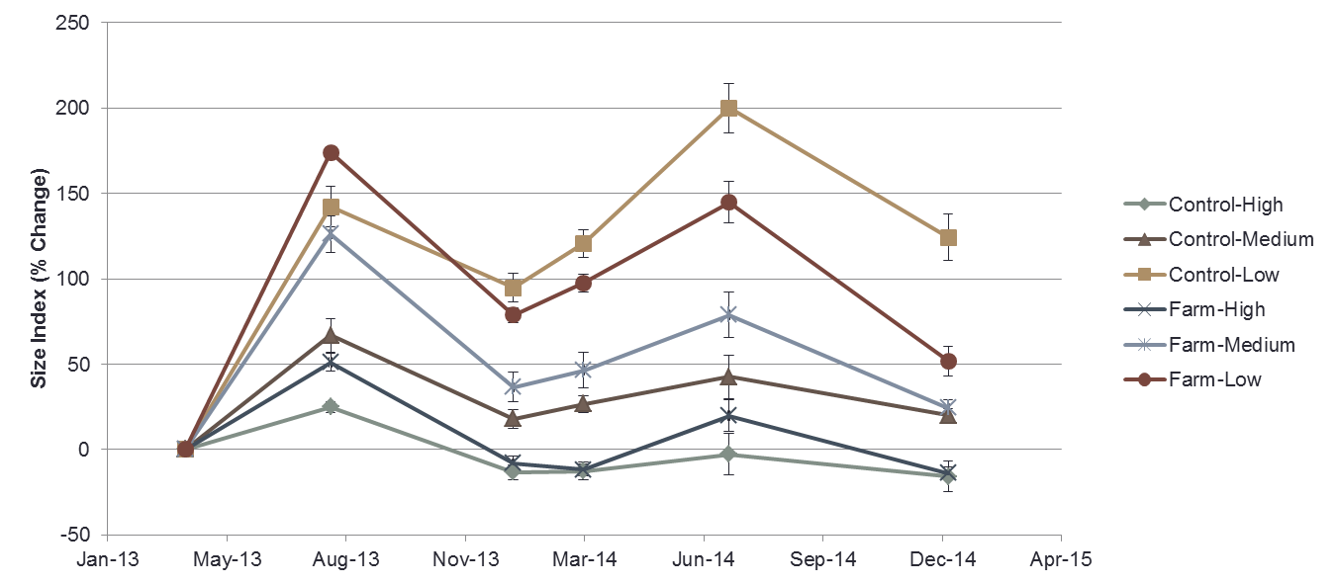
Grown in Benthic Cages?
Sea-based trials in benthic cages under oyster rafts and controls
Seasonal growth of sea cucumbers (>85% survival from Apr. 13 to Mar. 14)
Effect of density (1.5, 5.9, and 14.7 ind m⁻²)

Slide 34
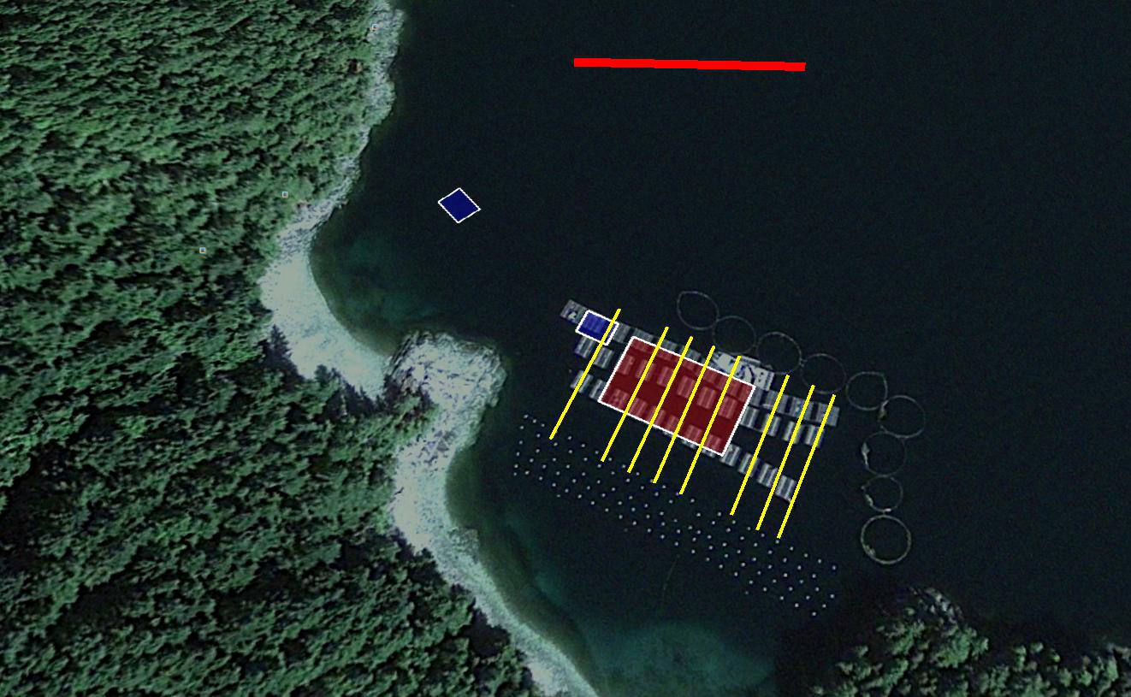
Is Containment Required?
100m
All sea cucumbers were removed from a 30 m x 50 m plot
8 permanent transects
  60 m long
  Divided into 5 m x 4 m Quadrats
All sea cucumbers were removed from a 30 m x 50 m plot
8 permanent transects
  60 m long
  Divided into 5 m x 4 m Quadrats
Control
Cages
Farm
Cages
Removal Plot
Transects
Village Bay, Quadra Island, BC

Slide 35
Is Containment Required?
Seasonal shifts in density suggest that sea cucumbers leave the farm in the winter
Movement back in spring/summer could be from off tenure and/or drop off from oyster gear

Slide 36
Does Sediment Restrict Movement?

Slide 37
Does Sediment Restrict Movement?

Slide 38
Does Sediment Restrict Movement?

Slide 39
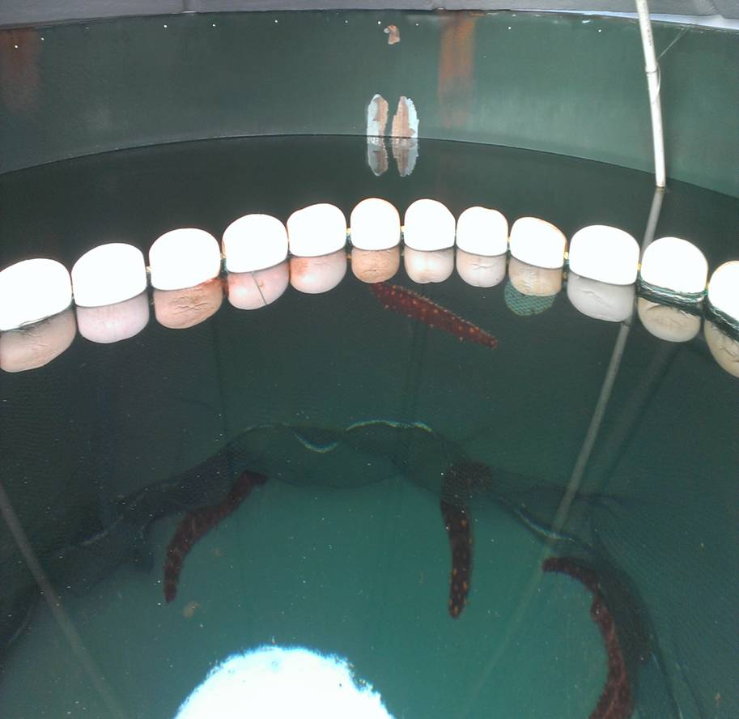
Do Fences Restrict Movement?
2 fence heights
  Halfway to surface (0.5 m) “Low”
  Above surface (1.0 m) “High”
2 fence types
  Vexar mesh (11 mm)
  Predator net (10 mm)
10 animals
Run for 47 h
10-ft tanks

Slide 40
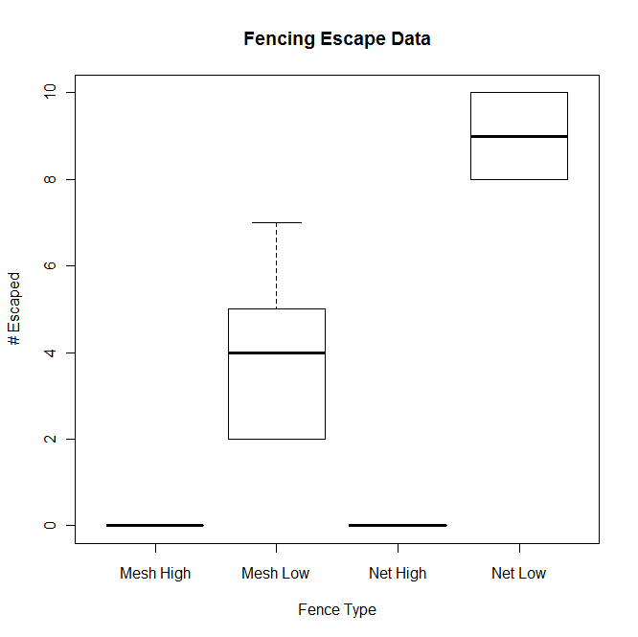
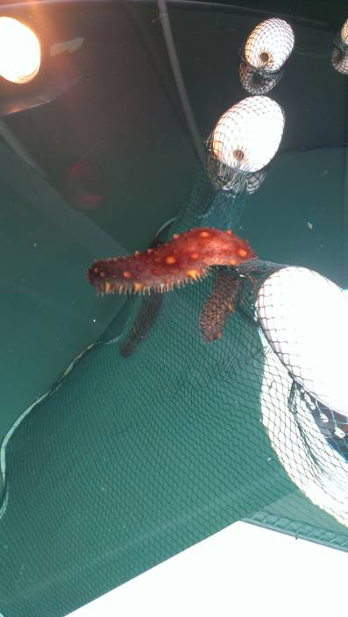
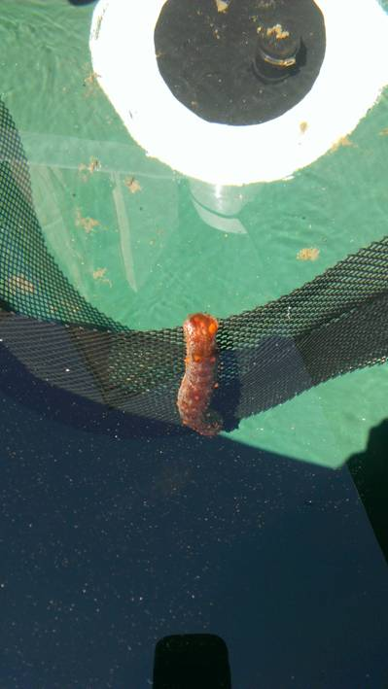
Do Fences Restrict Movement?
The only effective fencing is above the water surface.

Slide 41
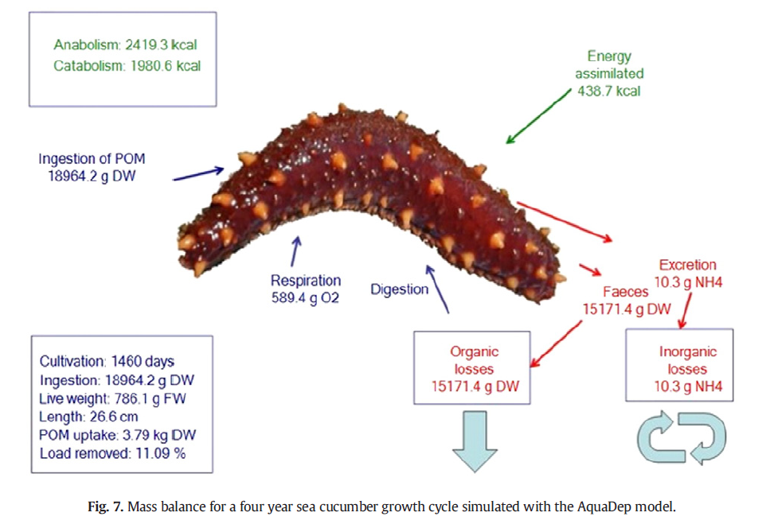
Sea Cucumber
Environmental Services

Slide 42
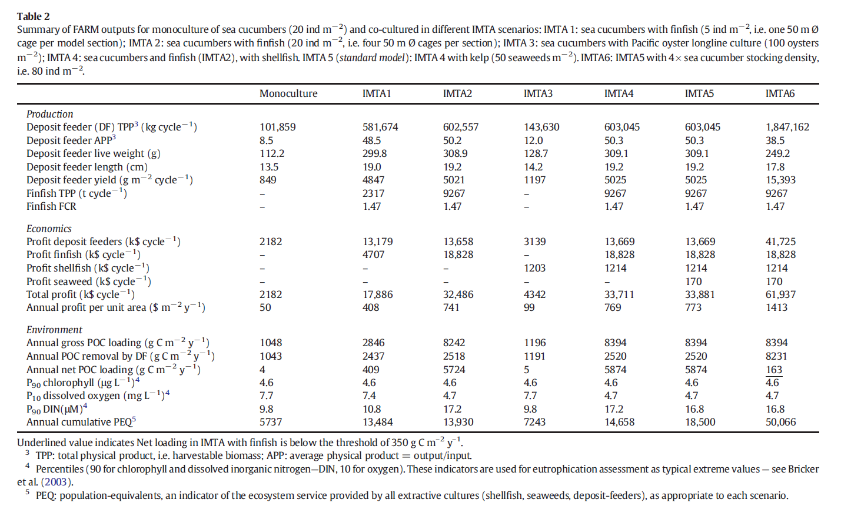
Sea Cucumber
Environmental Services

Slide 43
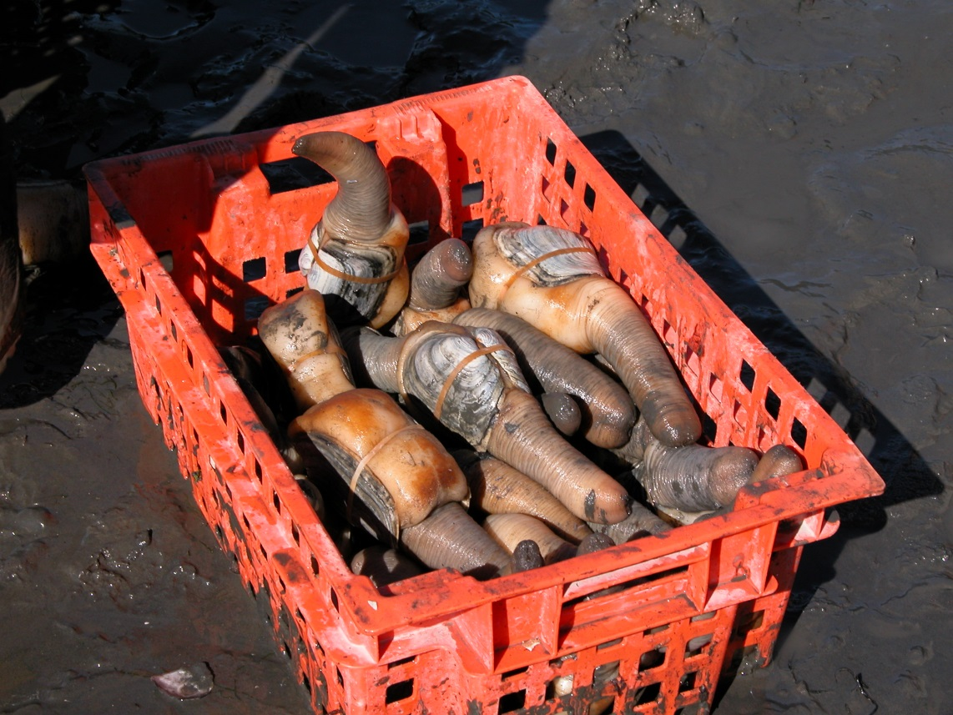
Geoduck Aquaculture
HQP: Dr. Alhambra Martínez Cubillo (Post-doc, Longline Environment Ltd.)
Collaborators: Dr. João Gomes Ferreira (Universidade Nova de Lisboa), Dr. Rob Marshall (Mac’s Oysters Ltd.), Dr. Dan Cheney (Pacific Shellfish Institute), Bobbi Hudson (Pacific Shellfish Institute)
Funding: PESCA

Slide 44
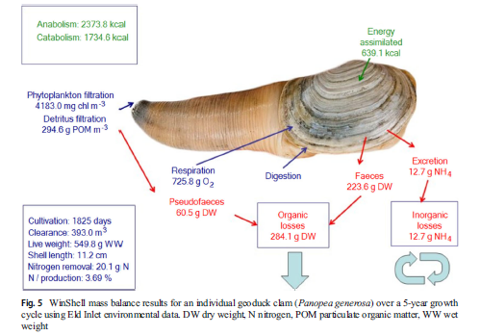
Geoduck Environmental Services

Slide 45
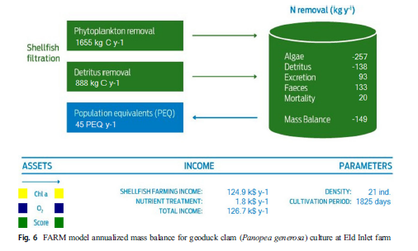
Geoduck Environmental Services
This represents a potential nutrient-credit trading value of over USD 1850 per year, which would add 1.48% to the annual profit (USD 124,900) from the clam sales (i.e. the provisioning service). A scaling exercise applied to the whole of Puget Sound estimated that cultured geoducks provide a significant ecosystem service, of the order of 11,462 PEQ per year (about USD 470,600) in removing primary symptoms of eutrophication, at the level of the whole water body.

Slide 46
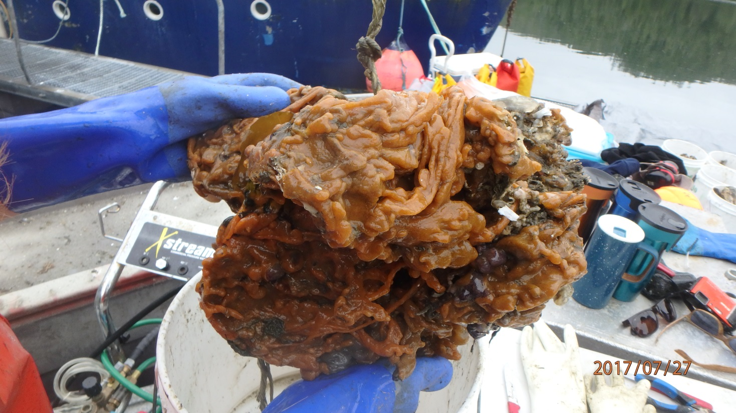
Shellfish Aquaculture and AIS
HQP: Julia Savery (Undergraduate, VIU)
Collaborators: Dr. Tom Therriault (DFO), Lyanne Curtis (DFO), Vanessa Hodes (DFO), Jocelyn Nelson (DFO), Callie Wasser (DFO)
Funding: SPERA

Slide 47
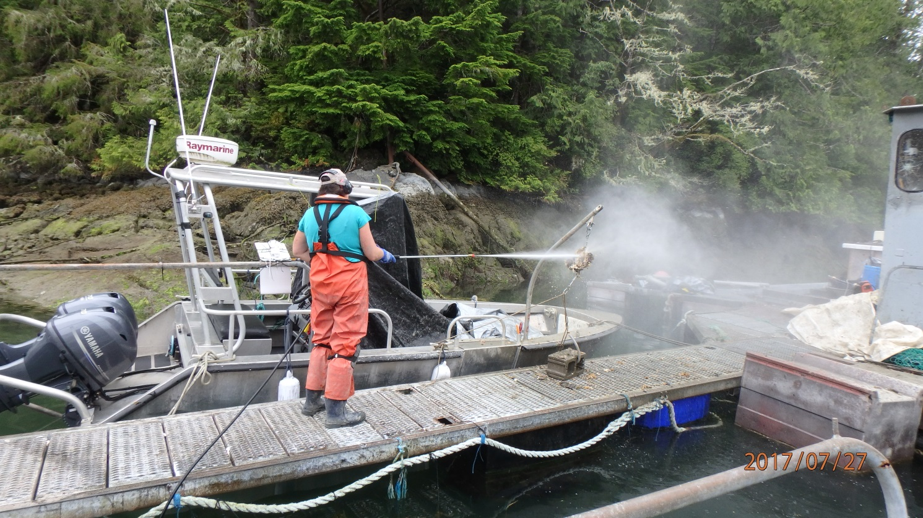
Shellfish Aquaculture and AIS
Treatments: control, dunk (5 times), pressure washing at 2000 and 3000 PSI for 10, 20, and 30 seconds
Examine reduction in total biofouling, AIS, and other species

Slide 48
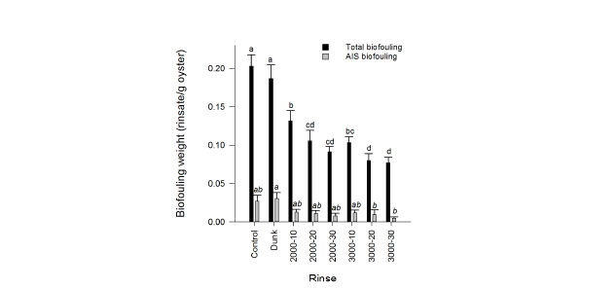
Shellfish Aquaculture and AIS

Slide 49
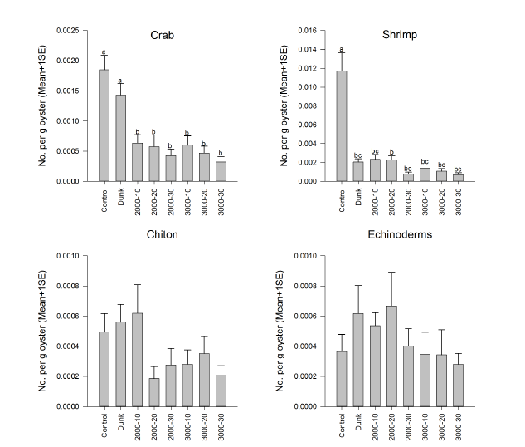
Shellfish Aquaculture and AIS

Slide 50
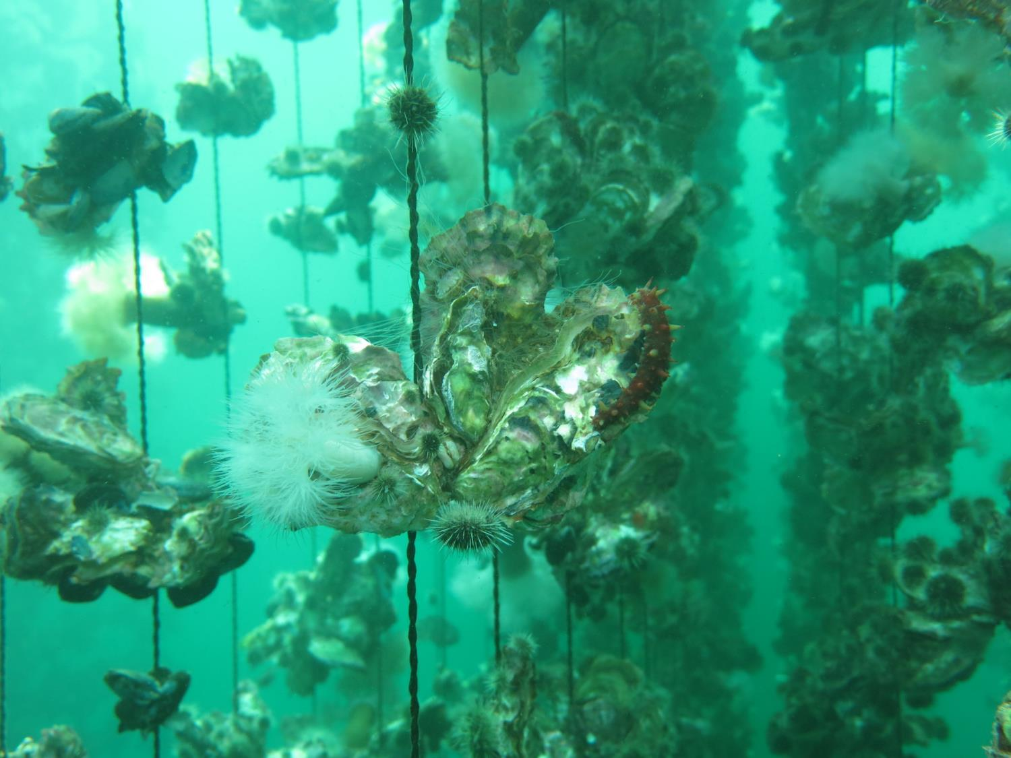
Questions?

